Slide 1

Carbon Capture
Viking CCS Pipeline Proposal Investigated

Slide 2
CO2 Capture and Burial – We Explore What it is
What is CO2 Capture?
Why Does it Affect Me?
Is it Safe
Has it Been Tried and Tested
What Can I do

Slide 3
What Is CO2 Capture
Fossil fuels - Gas ,Wood Pellets, Coal are burned to generate power
Burning these fuels creates CO2
CO2 Contributes to Global Warming
UK Government has signed up to reduce Carbon (CO2) Emissions to zero by 2050
Some believe that capture of the CO2 by means of chemical interaction is the way ahead
Proposal to bury the CO2 in the voids under the sea in the old gas fields
Fossil Fuel
Burned
Capture CO2
Compress CO2
Send it under the sea via a pipeline
CO2 Released

Slide 4
Why Does It Affect Me?

Slide 5
The Viking CCS Project
Go Straight to Secretary of State to avoid scrutiny and objection
Compulsory purchase anything along the route of the pipeline that is required to site the pipeline, associated shut off valves, and terminal facilities
Lay a pipe from Immingham to Theddlethorpe (former Conoco site) on land which is mostly agricultural NOT all of which will be buried
Build a facility to take the CO2
Scrub the CO2 from polluters in the South Humber area (and potentially overseas polluters) using chemicals
Compress the resulting output
Pump it down the pipeline
Pump it into the pockets beneath the sea where previously natural gas was extracted

Slide 6
Is It Safe?

Slide 7
Firstly – Let’s Look At The “Scrubbing” Process
To get the CO2 from exhaust gases produced as a result of petrochemical and power production amines are used.
The resulting output is processed (the dense phase), and the CO2 is captured, dewatered and compressed or heated so that the CO2 is ready for transportation down the pipelines.
This process creates Nitramines and Nitrosamines which are toxic in high concentration
Water from the dense phase processing, are very likely to contain some very strong acids such as carbonic, sulphuric and nitric
These acids react adversely with carbon steel which the pipeline is potentially will be made from
Localised failure by corrosion of pipelines especially ones which are in the 70 -90-degree range of bends is very possible.
There are 12 areas within the proposal which contain such bends

Slide 8
Let’s Look At The Proposed Pipeline

Slide 9
The Pipeline
Proposed 53-kilometre pipeline carrying CO2 at 1200 pounds per square inch
Circa 9858 tonnes of CO2
1 tonne of CO2 is around 553 cubic metres
The Safety Valves are to be spaced at 10.5 kilometres, 10.5 kilometres and 15.5 kilometres on the final leg to the Theddlethorpe terminal
This means 1953 tonnes between Immingham and valve one
1953 tonnes between valve one and valve two

Slide 10
How Much CO2 Will The Pipeline Carry?

Slide 11
How Much CO2 Will The Pipeline Carry?

Slide 12
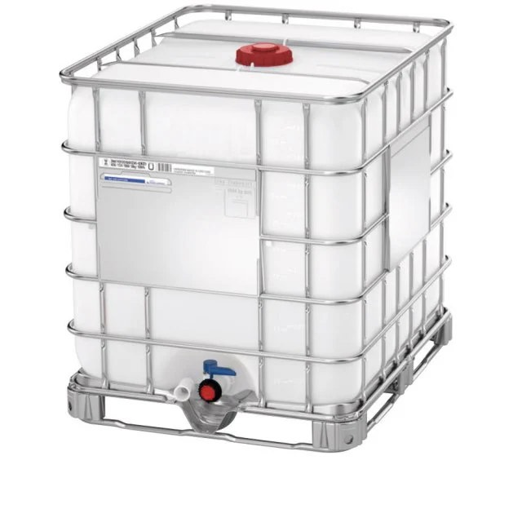
The Pipeline
At atmospheric pressure a metre of pipeline would contain 1030 cubic metres of CO2
1 Cubic Metre

Slide 13
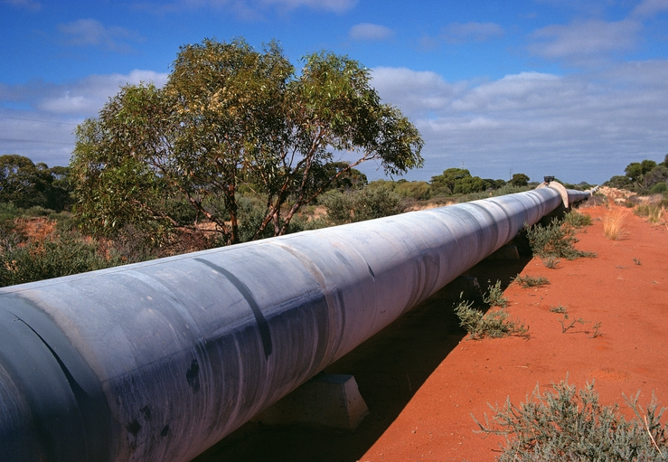

The Pipeline
1 metre
X 1030
This Photo by Unknown Author is licensed under CC BY

Slide 14
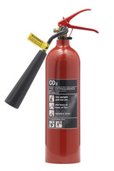
What is CO2?
Most Common Image of CO2 is a Fire Extinguisher
What Does an Extinguisher Do?
- Removes OXYGEN which stops the source of ignition

Slide 15
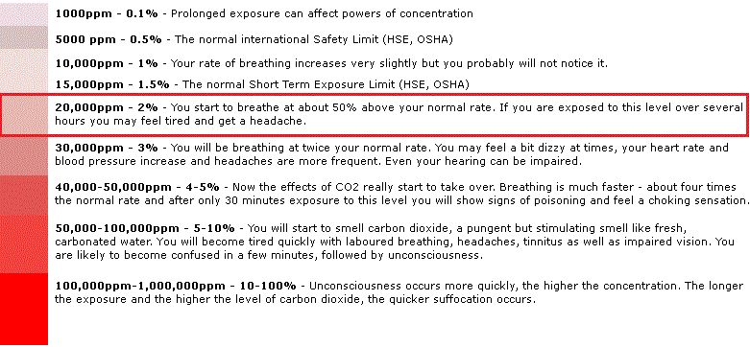
How Much CO2 is Safe?

Slide 16
Where Will The C O2 End Up?

Slide 17
Where Will The CO2 End Up?
Just off our coastline are some of the largest pockets beneath the ocean which once contained North Sea Gas
Now that the gas fields have been depleted, we are left with huge pockets or bubbles beneath the seabed
Viking CCS believe that the pockets which they are proposing to access would allow them to put 300 million tonnes of CO2

